Slide 1
Marketing Campaign for Fleet Owners
Business Description:
Fleet Owners is a leading provider of vehicle leasing, fleet management.
We envision a future where businesses seamlessly navigate their transportation needs with our expert assistance
Marketing Objective :
Increasing brand awareness
Boosting customer acquisition
Marketing campaign to support the strategy we will be utilizing
Targeted Online Advertising
Social Media Engagement
EDM to the customers
Aim is to increase customer growth 20 % by next 2 months

Slide 2
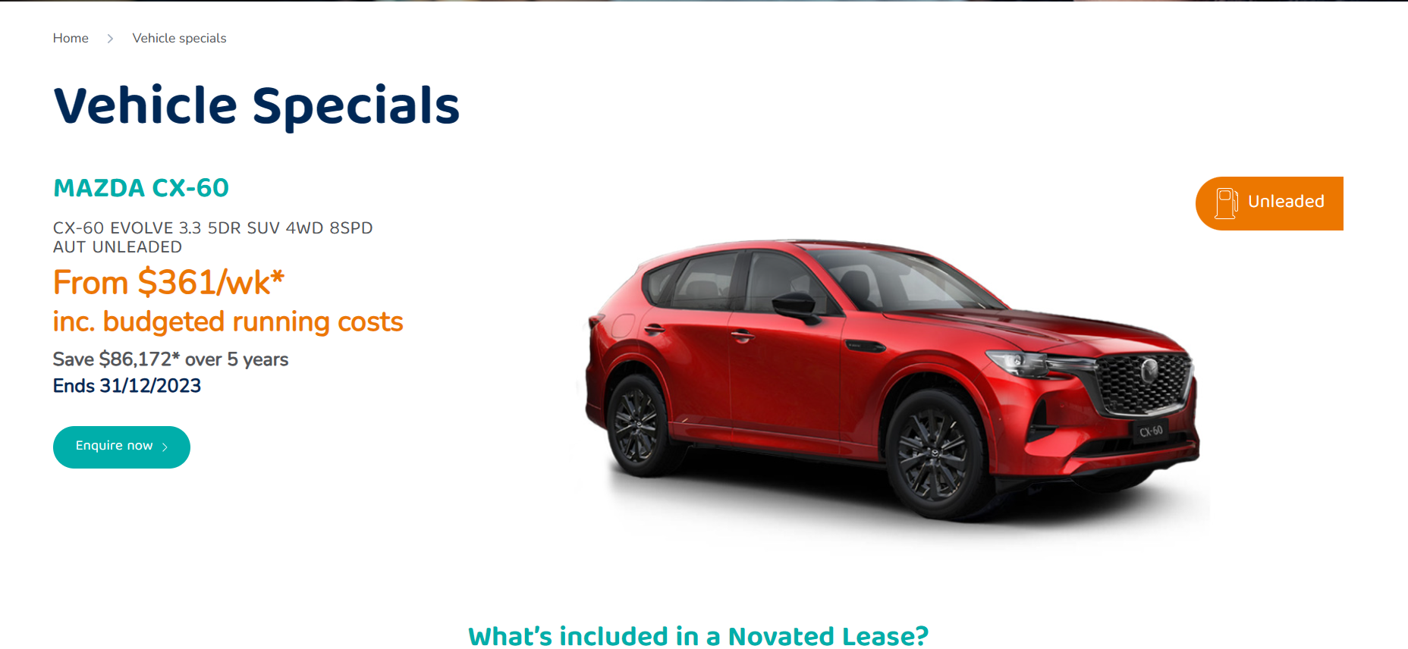
Landing Page & Analytics
TOFU (Top of Funnel): 4k customers discovering your brand.
MOFU (Middle of Funnel): 1200 customers interested and considering your services.
BOFU (Bottom of Funnel): 300 People ready to make a decision.
All marketing activity will be conducted as per the GDPR regulation and should be secured under the privacy act in Australia.

Slide 3
Google Ads Search Campaign
Conduct thorough keyword research to identify terms and phrases potential clients.
Consider both broad and specific keywords related to our industry, such as "fleet management solutions," "vehicle leasing services," and "professional fleet optimization.“
Target audience is in Australia so we will match and mirror, language, and demographic details, to ensure the ads reach the most relevant users.
Utilize Google's audience targeting options to refine our reach based on user behavior and interests.
Include a clear call-to-action (CTA) to encourage users to click on the ad and explore our services further.

Slide 4
Social Media
Platforms such as LinkedIn and Twitter particularly effective for B2B interactions.
Create or optimize social media profiles with accurate business information, a compelling bio, and eye-catching visuals that showcase Fleet Owners' brand identity.
Utilize high-quality images, a consistent logo, and a cohesive color scheme to enhance brand recognition
Actively engage with the audience by responding to comments, messages, and mentions promptly.

Slide 5
Re-engagement goal
Re- engagement – Basically we continue to engage with our current customers to retain their business and re-introduce into customer life cycle
Re-Targeting – A customer who is looking at the marketing material and is at conversion point, we can target these customer by multichannel approach by social media, email or using cookies.
Message and Offer
Exclusive Discounts: Present personalized discounts or promotions tailored to the individual's previous interactions or interests.
Latest Updates: Share the latest features, services, or industry insights to showcase our continuous innovation.
Special Re-engagement Package: Introduce a limited-time package or offer designed to entice them back into our service ecosystem.

Slide 6
Reporting
TOFU Metrics
Impressions
Click-Through Rate (CTR)
MOFU
Engagement Rate
Lead Generation
BOFU
Conversion Rate
Cost Per Acquisition
Retention
Customer Retention Rate
Customer Lifetime Value (CLV)
Notes:
Tofu - Measure the reach and visibility of our ads, indicating how many times they are displayed to users.
Evaluate the effectiveness of our ad copy and creative in encouraging users to click through to our landing pages
Assess the level of interaction with our content on social media and other platforms.
Track the number of leads generated through form submissions, sign-ups, or inquiries.

